Slide 1

ML22/23. Approve Prediction of Multisequence Learning
By :
Faiz Mohammed Khan (1427310)
Shiva Kumar Biru (1436929)
Mohan Sai Ram Sarnala (1428872)

Slide 2
OBJECTIVE
The primary objective of this project is to demonstrates how Multi-Sequence sequences are learned and then predicted.
Our Main aim is to Implement a new approach should automatically read and learn learning sequences from a file. The sample should read testing subsequences from a different file when learning is complete and determine the prediction accuracy.

Slide 3
TABLE OF CONTENT
INTRODUCTION
METHODOLOGY
MULTISEQUENCE LEARNING
IMPLEMENTATION (LEARNING & PREDICTION PHASE)
RESULTS
CONCLUSION

Slide 4
INTRODUCTION
Medical scientists and machine learning engineers were collaborating to better understand the cortex for temporal pattern recognition.
For sequence learning, HTM (Hierarchical Temporal Memory) has been proposed.
HTM is a biomimetics model based on the memory prediction principle.
Multisequence Learning is the process of memorizing multiple sequences.

Slide 5
METHODOLOGY

Slide 6
WORKING OF SPATIAL POOLER
Builds SDR input
Inactive columns are not learned.
Every input pattern is checked against the database.

Slide 7
IMPLEMENTATION (LEARNING & PREDICTION PHASE)
For Numbers :
Obtain datasets and train with Spatial Pooler using a scalar encoder.
Spatial Pooler iteratively trains each sequence until it reaches a stable state.
HTM is a memory-based system that stores a large number of patterns and sequences.

Slide 8
IMPLEMENTATION

Slide 9
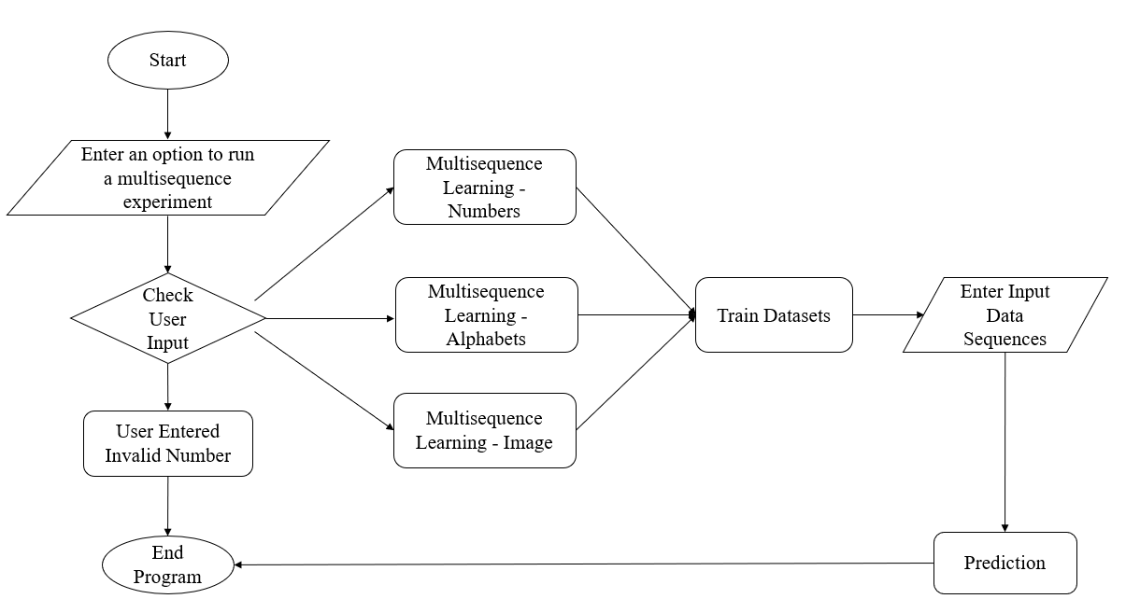
FLOW-CHART

Slide 10
RESULT

Slide 11
CONCLUSION

